Slide 1

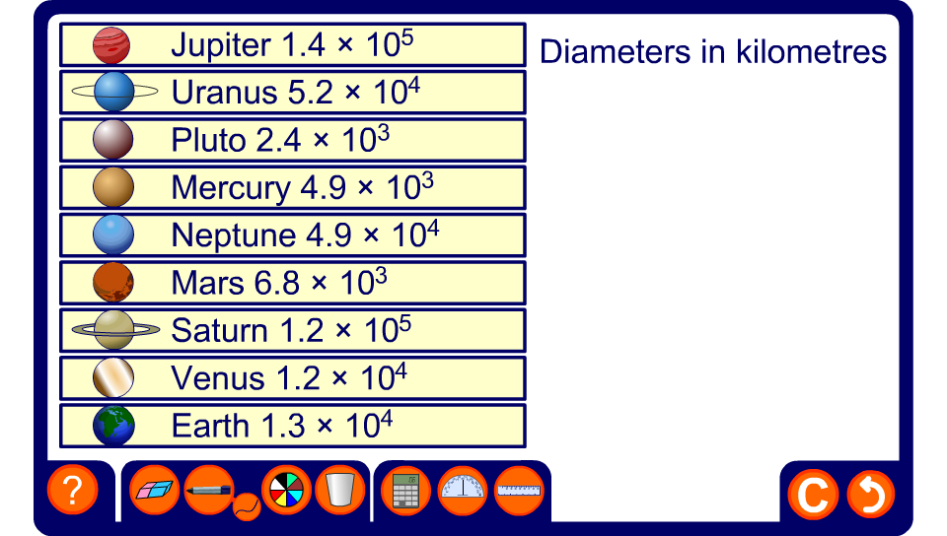


Ordering planet sizes
Notes:
The diameter of each planet is given in standard form. Ask a volunteer to come to the board and put the in the correct order from smallest to biggest.

